Slide 1


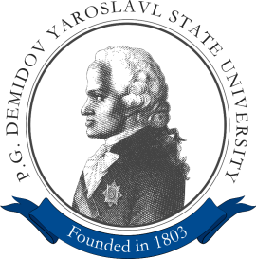
Deep learning for real-time robust facial expression analysis
Khryashchev Vladimir
Ivanovsky Leonid
Priorov Andrey

Slide 2
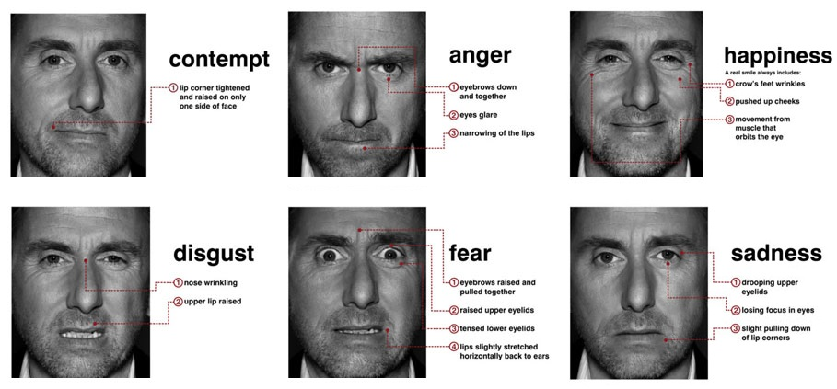
Purpose
Development of algorithm of facial expression recognition and smile detection on face image based on deep convolutional neural network

Slide 3




Usability
Video games
Safety
Psychiatry
Educational software

Slide 4
Peculiarities of facial recognition systems
Fully automatic
Support of video streams and static images
Real-time
Recognize spontaneous expressions for different viewing angles
Robust against lighting conditions, resolutions of data and people

Slide 5
Stages of recognition
Capture face images from the database or video stream
Preprocessing (interference reduction, filtering, sharpening, etc.)
Generation of set of features
Classification

Slide 6
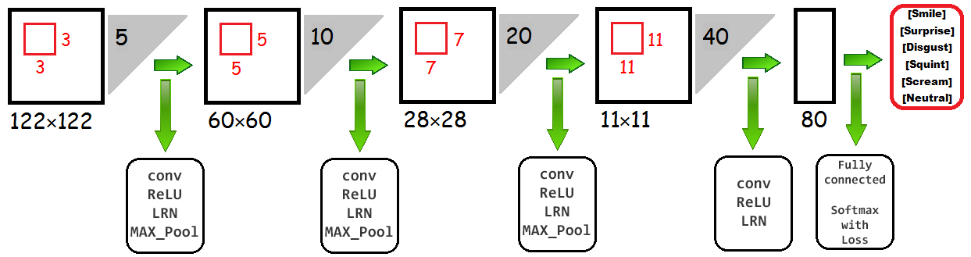
Simple convolutional neural network
Numerical optimization algorithm: stochastic gradient descent (SGD)
Z. Niu, M. Zhou, L. Wang, X. Gao, G. Hua, “Ordinal Regression with Multiple Output CNN for Age Estimation”, 2016 IEEE Conference on Computer Vision and Pattern Recognition, 2016, pp. 4920–4928.

Slide 7
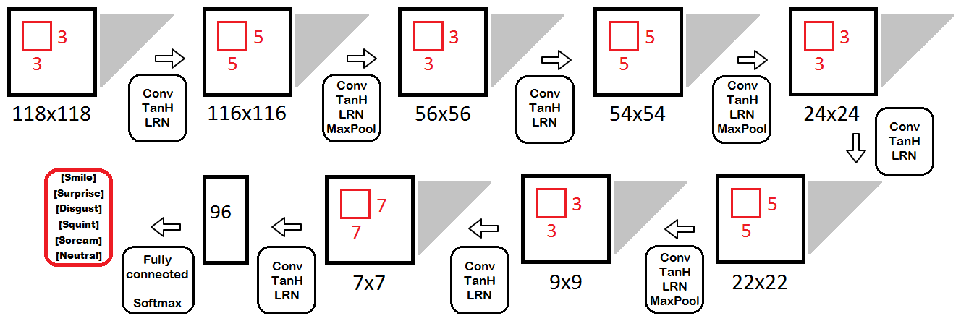
Complicated convolutional neural network
Added more convolutional layers
Changed sizes of convolutional layers
Added more activation and normalization layers

Slide 8
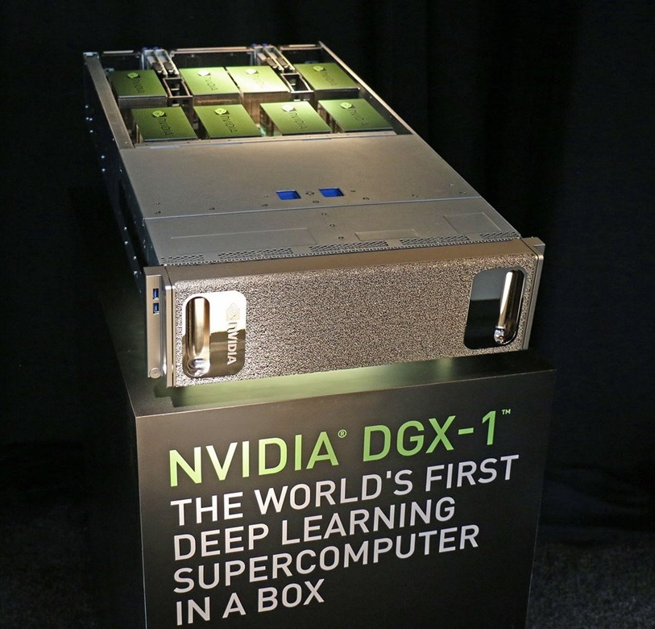
Training and testing
Training: ~45 min
Testing: ~8-10 min
Artificial Intelligence Center of P.G Demidov Yaroslavl State University

Slide 9
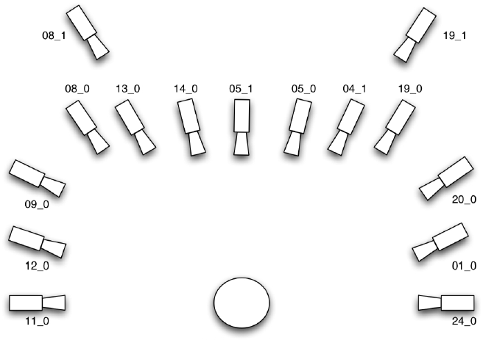
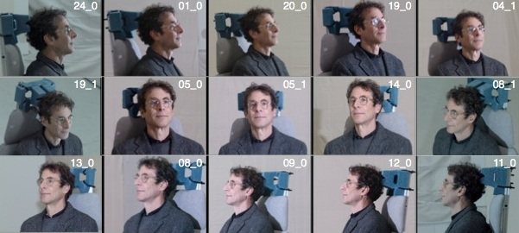
Multi-PIE Face Database
~750000 color images
337 different subjects
different angles (less than 90°) with various scene illumination
http://www.cs.cmu.edu/afs/cs/project/PIE/MultiPie/Multi-Pie/Home.html

Slide 10
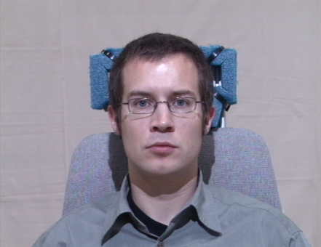
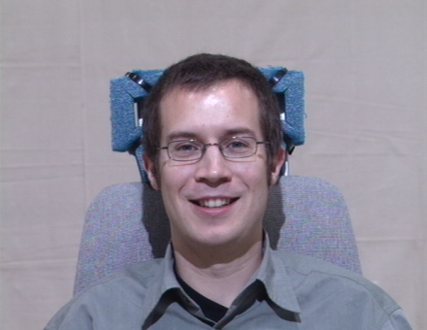
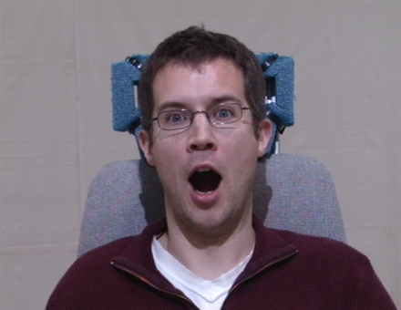
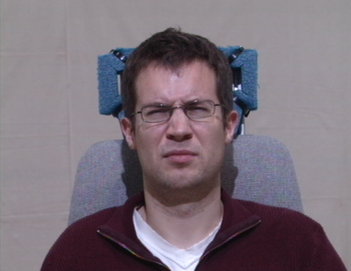
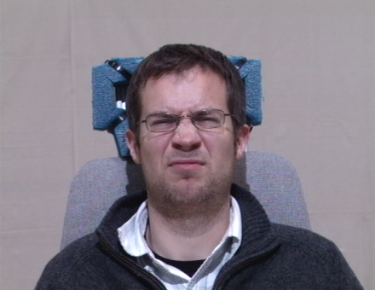
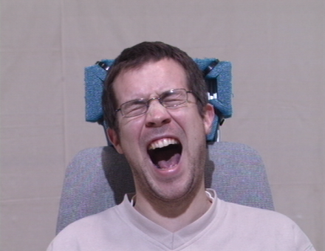
Classes of facial expression
a) Neutral
b) Smile
c) Surprised
d) Squint
e) Disguist
f) Scream
http://www.cs.cmu.edu/afs/cs/project/PIE/MultiPie/Multi-Pie/Home.html

Slide 11
Sampling
210000 randomly selected and mirrorred images
(35000 images for each type of emotions)
Labelling: 6 classes for facial emotion recognition
Angle of view: [-45, 45]
Train and test samples: 80/20

Slide 12
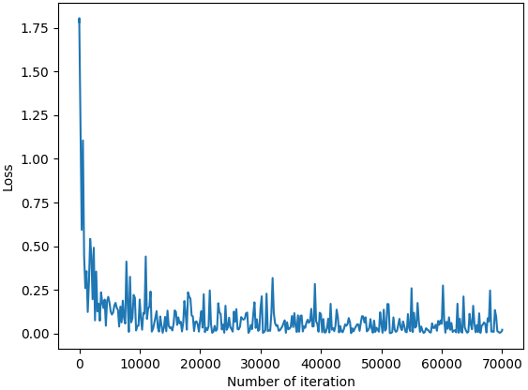
Results
Model | Accuracy
Simple | 92,29%
Complicated | 94,48%

Slide 13
Results
Classes |  | Real class
 |  | Smile | Surprise | Disgust | Squint | Scream | Neutral
Predicted class | Smile | 6471/ 6526 | 48/ 37 | 68/ 53 | 8/ 6 | 4/ 1 | 136/ 145
 | Surprise | 87/ 140 | 6715/ 6767 | 3/ 2 | 1/ 0 | 47/ 16 | 30/ 8
 | Disgust | 102/ 72 | 28/ 2 | 6006/ 6322 | 556/ 334 | 34/ 33 | 61/ 43
 | Squint | 143/ 148 | 20/ 2 | 749/ 541 | 6112/ 6479 | 12/ 9 | 184/ 166
 | Scream | 53/ 21 | 98/ 156 | 48/ 18 | 22/ 7 | 6903/ 6940 | 26/ 1
 | Neutral | 144/ 93 | 91/ 36 | 126/ 64 | 301/ 174 | 0/ 1 | 6563/ 6637

Slide 14
Results
Error analysis |  | Metrics
 |  | Precision (P) | Recall (R) | F-score (F)
Classes | Smile | 0,96/ 0,96 | 0,82/ 0,93 | 0,94/ 0,95
 | Surprise | 0,98/ 0,98 | 0,96/ 0,97 | 0,97/ 0,97
 | Disgust | 0,89/ 0,93 | 0,86 0,9 | 0,87/ 0,92
 | Squint | 0,85/ 0,88 | 0,87/ 0,93 | 0,86/ 0,9
 | Scream | 0,97/ 0,97 | 0,99/ 0,99 | 0,98/ 0,98
 | Neutral | 0,91/ 0,95 | 0,92/ 0,95 | 0,92/ 0,95

Slide 15
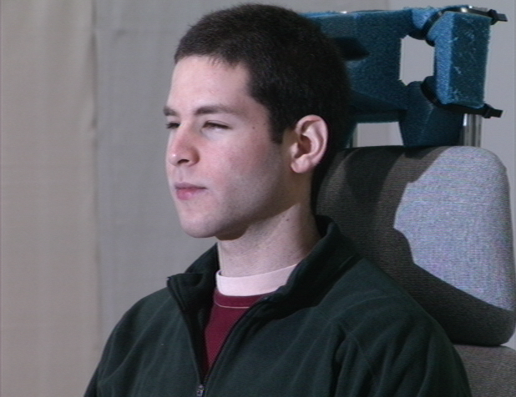
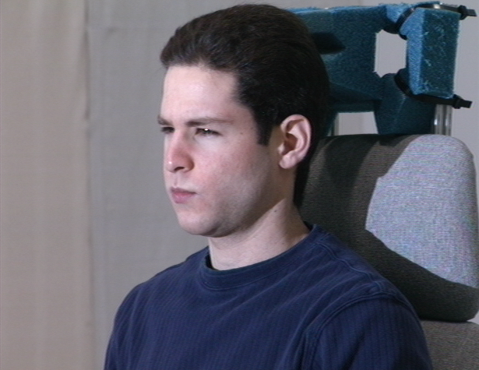
Distinguishable facial expressions
a) Squint
b) Disguist

Slide 16
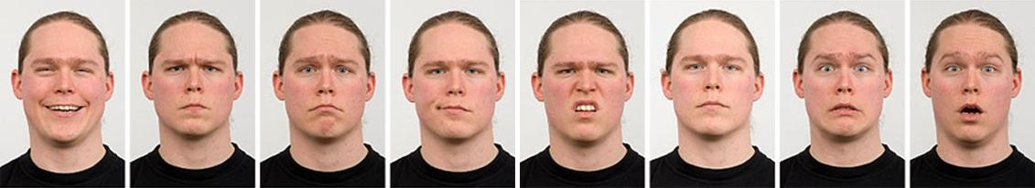
Development
Testing for other databases of face images
Radboud Faces Database:
more than 8000 colour images of 67 different subjects
5 angles of view : 0°, 45°, 90°, 135°, 180°
8 facial expressions (neutral, sadness, contempt, surprise, happiness, fear, anger, and disgust)
http://www.socsci.ru.nl:8180/RaFD2/RaFD?p=main

Slide 17

Development
Testing for other databases of face images
FER2013 Database:
black-and-white images of 48x48
3 sets: training (28709 images), validation (3589 images), testing (3589 images)
7 facial expressions (anger, disgust, fear, happiness, sadness, surprise, neutral)
https://www.kaggle.com/c/challenges-in-representation-learning-facial-expression-recognition-challenge/data

Slide 18

Development
Testing for other databases of face images
AFEW:
contain video materials from Hollywood movies.
each video is labelled on time slices
contain people of different ages, focuses and resolutions of faces
labelling includes information about names and ages of actors, ages for their role, facial expressions and cues
6 facial expressions (anger, disgust, fear, happiness, surprise, neutral)

Slide 19
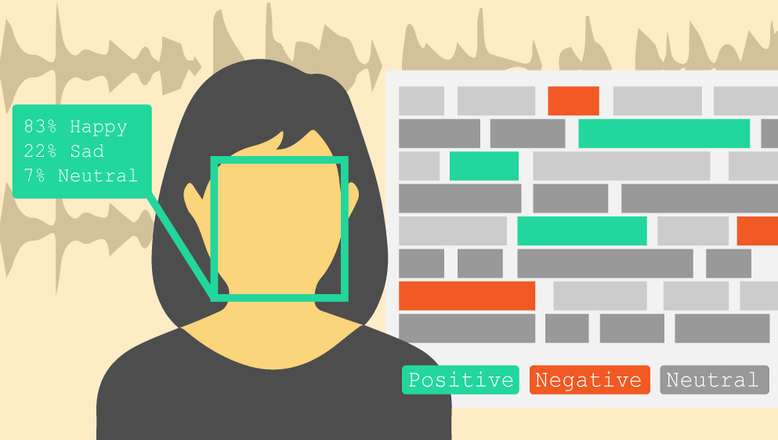
Development
Plug in cameras and test on real images
Use of algorithm in real-time applications or special solutions for embedded systems

Slide 20
Deep learning for real-time robust facial expression analysis
Khryashchev Vladimir
Ivanovsky Leonid
Priorov Andrey

